Slide 1
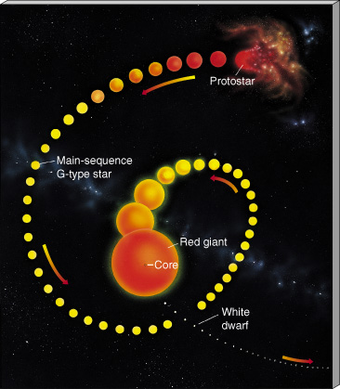
PHAS 0004
2 – Spectra and stellar classification

Slide 2
Spectroscopy
➔ decode physical information from the details of lines in the spectrum of light coming from planets, stars, galaxies, etc.
This tool is used by chemists, biologists, physicists and all of the other natural sciences.
It is based on the quantum or particle (photon) nature of light.

Slide 3
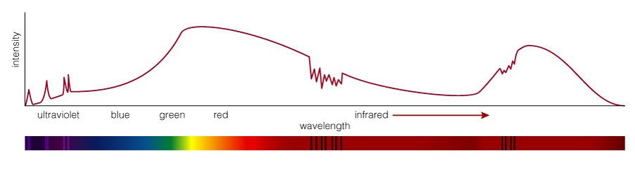
What are the three basic types of spectra?
Continuous Spectrum
Emission Line Spectrum
Absorption Line Spectrum
Spectra of astrophysical objects are usually combinations of these three basic types: how they arise is described by Gustav Kirchhof’s Laws.

Slide 4
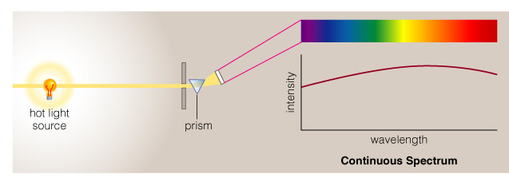
Continuous Spectrum
Example: The spectrum of a common (incandescent) light bulb spans all visible wavelengths, without interruption. (star’s interior)
A hot solid, liquid or dense gas produces a continuous thermal spectrum (Kirchhof’s 1st Law)

Slide 5
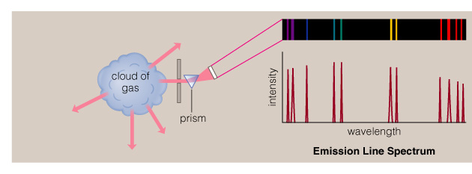
Emission Line Spectrum
A thin or low-density cloud of gas emits light only at specific wavelengths that depend on its composition and temperature, producing a spectrum with bright emission lines (Kirchhof’s 2nd Law).

Slide 6
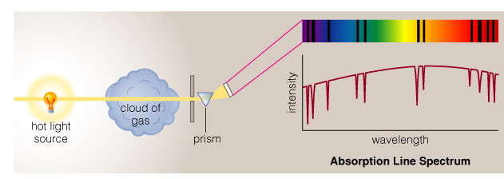
Absorption Line Spectrum
A cloud of gas between us and a light bulb can absorb light of specific wavelengths, leaving dark absorption lines in the spectrum: Kirchhof’s 3rd Law

Slide 7
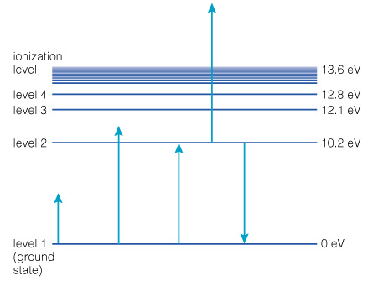
Reminder -- Energy Level Transitions
The only allowed changes in energy are those corresponding to a transition between energy levels (here, Hydrogen)
Not Allowed
Allowed

Slide 8
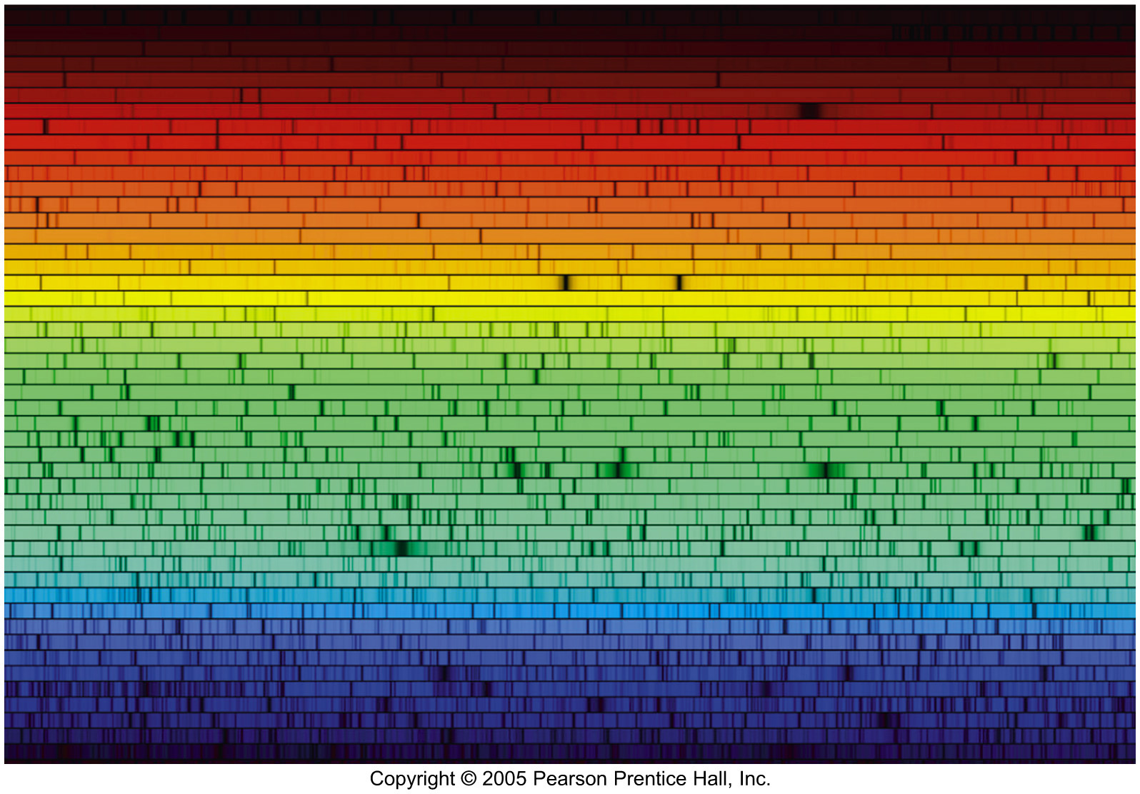
The solar spectrum
Notes:
The solar spectrum consists of a continuum with thousands of dark absorption lines superposed. The lines are called the Frauenhofer lines, and the solar spectrum is sometimes called the Frauenhofer spectrum. These lines are produced primarily in the photosphere.

Slide 9

Spectrum of the hydrogen atom
13.6eV
Paschen series (IR)
n=4
Balmer series (optical)
1.9μm
n=3
12.1eV
Pγ Pβ Pα
4340A
4861A
6562A
n=2
10.2eV
Hγ Hβ Hα
λ
Lyman series (UV)
δ γ β α
1216A
n=1
0eV
Lyγ Lyβ Lyα
normalised energy scale
Notes:
21 cm line (ZG, p. 294): A moving charge produces a magnetic field → both electron and proton in the atom have dipolar magnetic fields generated by their spin. Their magnetic moments can be parallel (then electron and proton will slightly repel each other) or anti-parallel (the two will be more tightly bound; lower energy state) → the two states have slightly different energies, the so called ‘hyperfine splitting’ of the neutral H ground state.
Spontaneous transition between the two states can occur, accompanied by a flip in the electron spin and the emission of a 21 cm photon. Spontaneous transition is forbidden, though, and occurs on average once every few million years.
A collision between two H atoms in the ISM generally implies the transfer of the electron from one atom to the other, and a change in their hyperfine states. Such change takes place every 400 years on average for a given atom → equilibrium established with aligned : opposite = 3 : 1. Enough neutral H atoms exist in the ISM to produce a detectable 21 cm (emission) line.

Slide 10
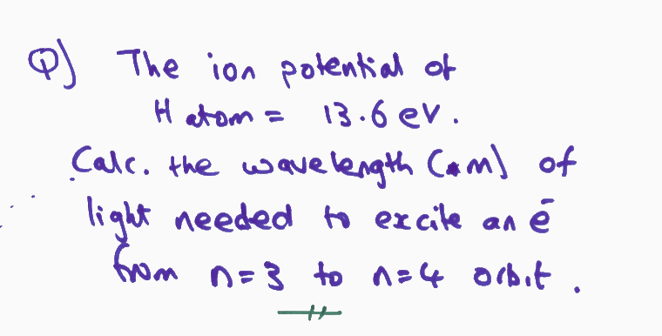
Insert – e.g.

Slide 11
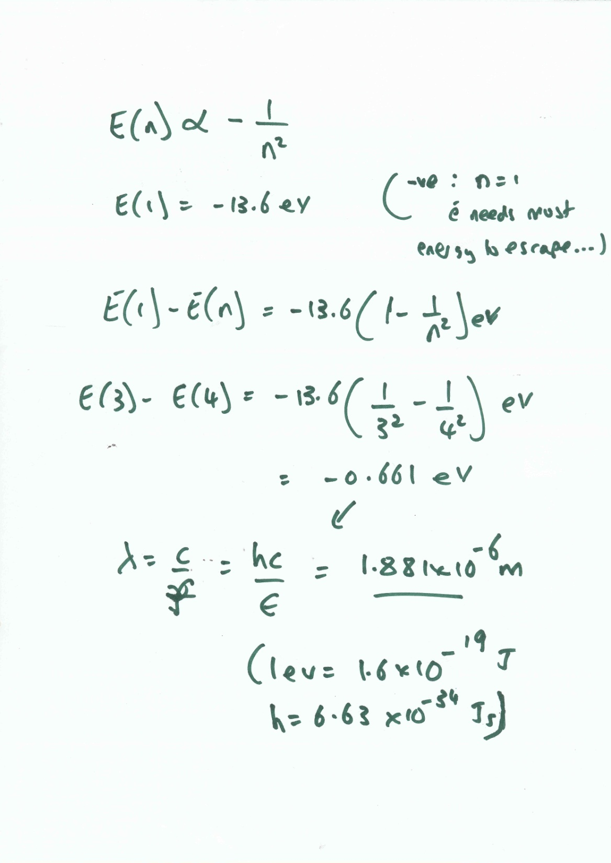

Slide 12
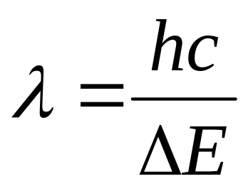
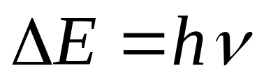
Emission lines
To produce emission lines, an excited state must first be populated – when the electron in an excited state falls by one or more levels, an emission line is produced.
..
I(λ)
wavelength, λ

Slide 13

Emmision lines -- e.g. Photo-excitation
n=
n=5
n=4
n=3
n=2
n=1
If a photon with the right energy interacts with an atom or ion, an electron can be moved up to a higher level for a short while, before it falls back down to the ground state.

Slide 14
Emission Nebula
(photo-excited or photo-ionized)
optically thin nebula:
passes most wavelengths
Star emits continuum
- light at energy equal to an atomic transition is absorbed
- that light is then reemitted in a
random direction (some of it towards the observer)
- the nebula may be optically thick at these wavelengths
The only light directed towards
the observer is that which has
energy equal to the atomic
transitions in the nebula:
an emission spectrum

Slide 15
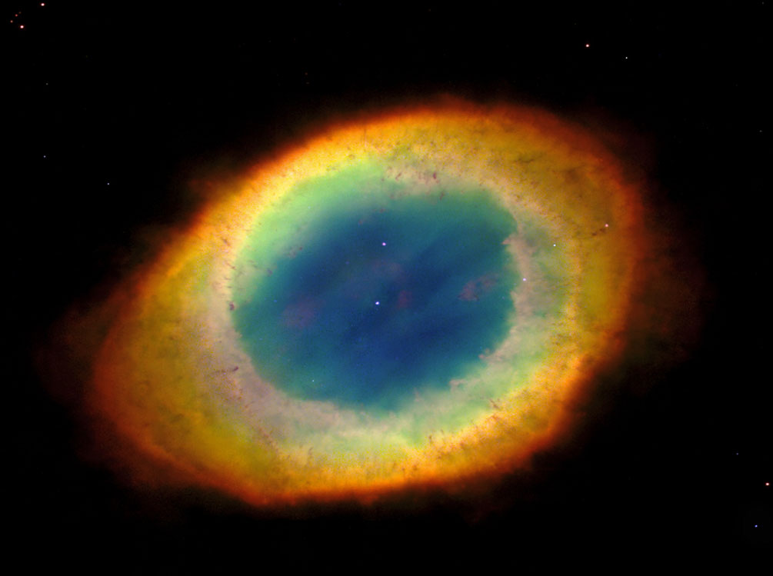
e.g. Planetary Nebula

Slide 16
Absorption Feature:
the observer sees all the
wavelengths except those
at the atomic transition energy
an absorption spectrum
F
Star emits continuum
- light at energy equal to an atomic
transition is absorbed
- that light is then reemitted in a random direction
F_{λ}
λ

Slide 17
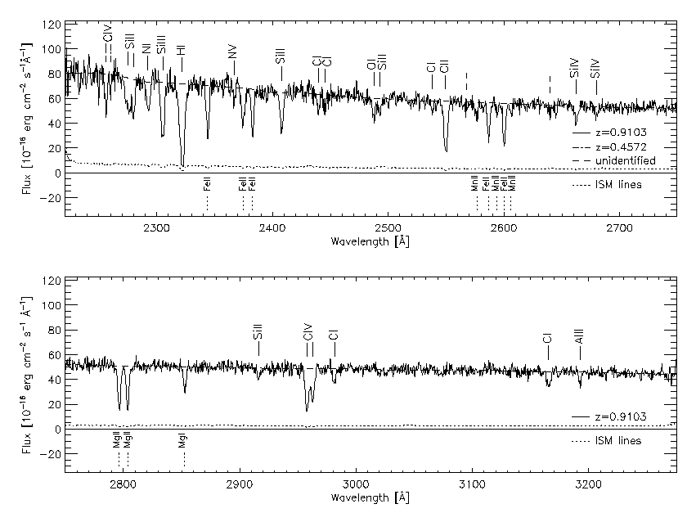
QSO Spectrum with IGM Absorption

Slide 18
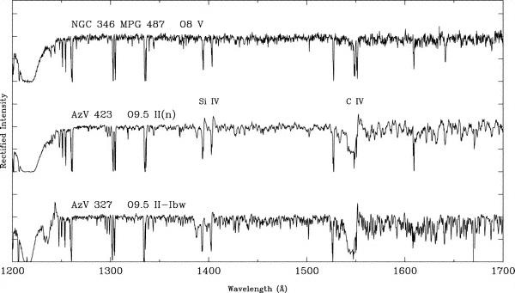
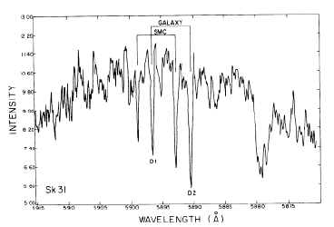
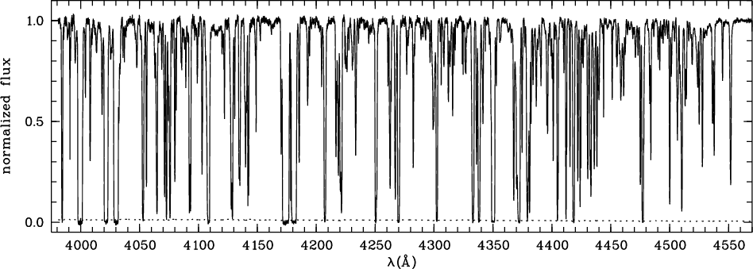
Sources of absorption lines
outer layers absorb blackbody
emission from the star
Stellar atmospheres
star
photosphere
gas cloud
Interstellar gas
star
Intergalactic Lyα systems of clouds at different redshifts
quasar
‘Lyα forest’
Notes:
Stellar spectra from PUBLICATIONS OF THE ASTRONOMICAL SOCIETY OF THE PACIFIC, 116: 909-919, 2004 October
ISM absorption (Na lines in the SMC supergiant Sk 31) from Astrophysical Journal, Part 1, vol. 242, Dec. 15, 1980, p. 976-986.
Lyman_alpha forest on the quasar HS 1700+6416 (at z = 2.72) as seen with the Keck telescope, from A&A 455, 91-106 (2006).

Slide 19
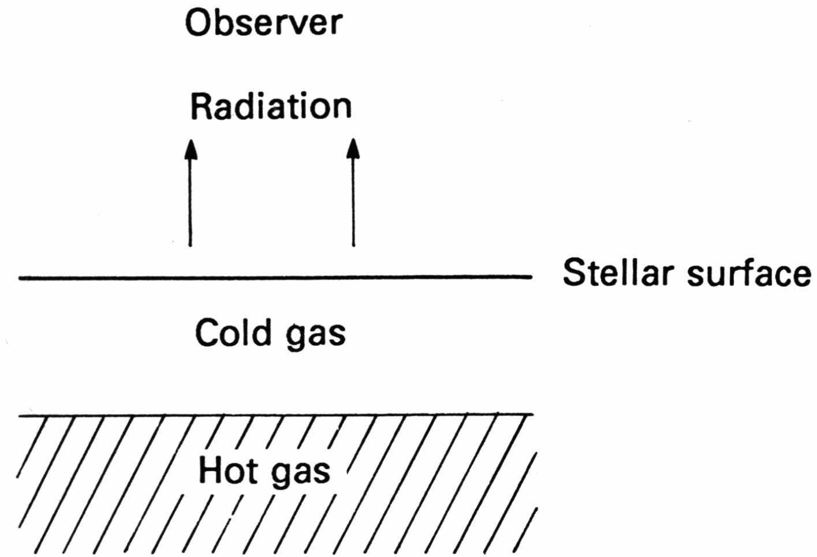
How absorption lines form in stars

Slide 20
Spectrometers
Most telescopes spend most of their time measuring spectra of stars, gas clouds and galaxies. WHY?
Spectra tell us:
Compositions: elements & molecules (line positions)
Temperatures (line strengths)
Abundances (line strengths)
Pressures (line widths: pressure broadening)
Radial velocities (Doppler shift)
Rotation (Doppler broadening)
Magnetic fields
And, indirectly, masses, ages, distances, sizes and MORE!
➔ ASTROPHYSICAL LABORATORIES

Slide 21
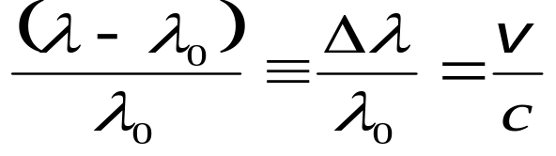
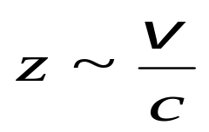
Doppler effect
The Doppler effect is of fundamental importance in astrophysics.
The observed wavelength, λ, is different from the emitted wavelength, λ₀, due to the radial velocity of the emitter with respect to the observer:
λ = observed wavelength
λ₀= ‘rest’ wavelength
v = source’s radial velocity
> λ₀ implies a ‘redshift’ of the light, v > 0, the emitter is moving away from the observer
< λ₀ implies a ‘blueshift’ of the light, v < 0, the emitter is moving towards the observer
‘Astronomical redshift’ when z << 1
Notes:
This is the classical formula for the redshift. When z approaches 1 (for which it would be v = c) we must use the relativistic formula: z + 1 = [(1 + v/c)/(1 – v/c)]**0.5

Slide 22
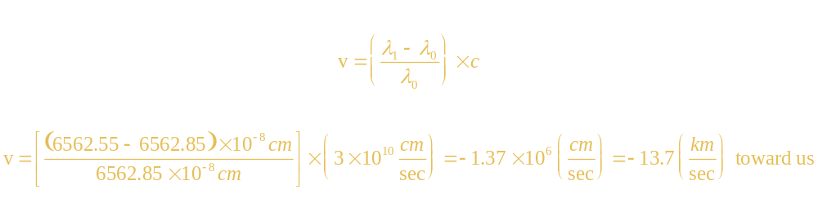
Example of Doppler shift
(in class; PST)

Slide 23
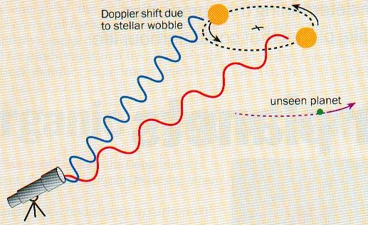
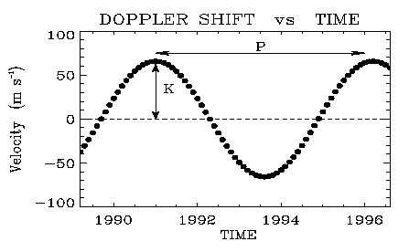
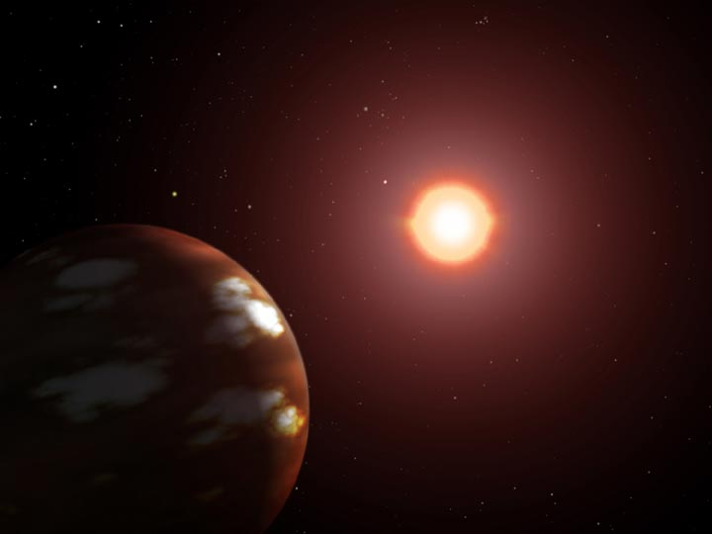
e.g. >4000 extra-solar planets →
Doppler method

Slide 24
How do we interpret an actual spectrum?
By carefully studying the features in a spectrum, we can learn a great deal about the object that created it.

Slide 25
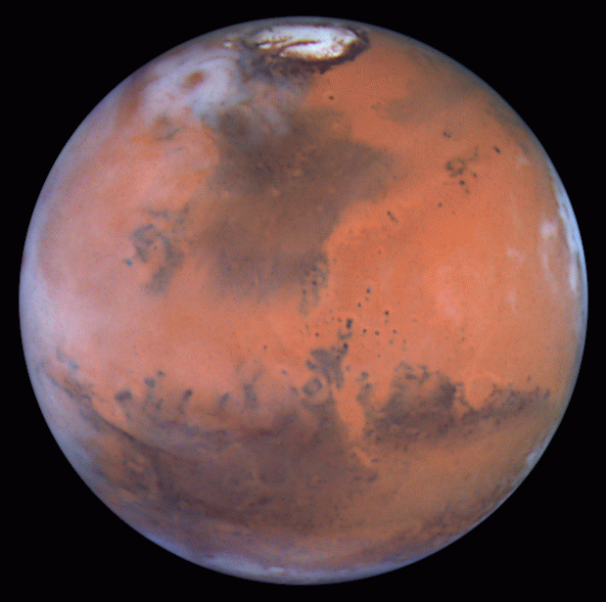
Spetrum
Mars!

Slide 26
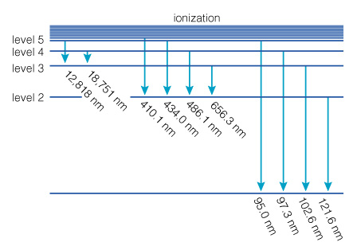
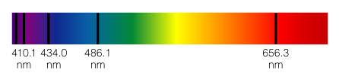
Chemical Fingerprints
atoms can absorb photons with those same energies ➔ transitions produce a pattern of absorption lines

Slide 27
Stellar classification
From 1910, adopted Harvard (or Henry Draper; HD) spectral classification system
Based on spectral characteristics
This gives information about temperature in an alternative way
Absorption lines can be observed only for a certain range of temperatures
The range involved shows atomic energy levels which have been populated

Slide 28
The Harvard classification
O
B
A
F
G
K
M
emission
absorption
H
II
He
I
II
metals
I
III
O,N
II
molecules
blue-white
white
yellow
red
Teff
[K]
30000
10000
5000
3000

Slide 29
Divisions and subdivisions
…later …. discovered that the strength of the hydrogen line was connected with the surface temperature of the star.
These classes are further subdivided by numbers (0-9)
A0 denotes the hottest stars in the A class and A9 denotes the coolest ones
The sun is classified as G2.

Slide 30
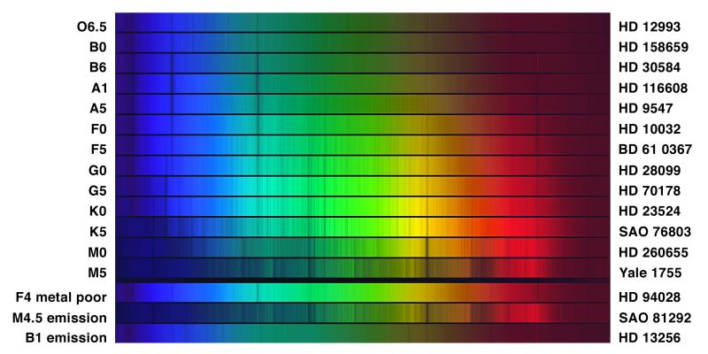
Stellar spectral types (2)
O, B, A, F, G, K, M
Early
Late
Sub-class: O2-O9, B0-B9... 0 hotter, 9 cooler
(evolutionary sequence not implied)
Notes:
Spectra from http://spiff.rit.edu/classes/phys440/lectures/spec_class/spec_class.html
Probably covering range ~4000-5000 A: CaII ~4000 A
HeI 4471
HeII 4686
Hβ 4861
TiO 4761 & 4955

Slide 31
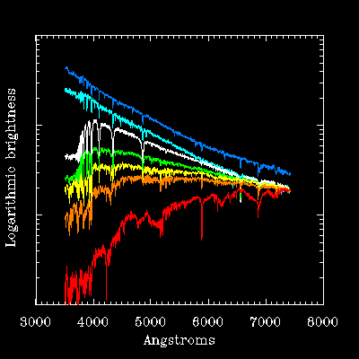
Actual stellar spectra look something like this!

Slide 32
Stellar spectral types
Spectral class | Colour | Surface temp (K) | Main lines | Example
O | Blue-violet | 30000-50000 | He II | Naos
B | Blue-white | 11000-30000 | He I | Rigel, Spica
A | White | 7500-11000 | H, Fe II, Si II, Mg II | Sirius, Vega
F | Yellow-white | 6000-7500 | Ca II | Canopus, Procyon
G | Yellow | 5000-6000 | Ca II, Fe I, CH | Sun, Capella
K | Orange | 4000-5000 | Ca II, Fe I | Arcturus, Aldebaran
M | Red-orange | <4000 | Fe I, TiO | Betelgeuse, Antares

Slide 33
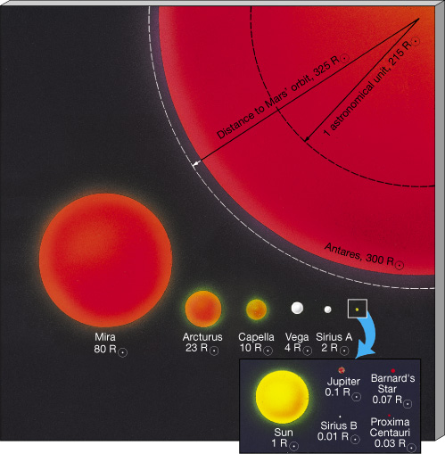
Different groups of stars in our Galaxy: dwarfs (Sun), giants and supergiants
L = 4 π R² σ T⁴
Temperature, Raduis ➔
Luminosity

Slide 34
thus two-dimensional…..
Difference in stars is not just their chemical make up but their surface temperature AND size
Spectra of two stars with same temperature but different sizes is not the same
+ larger star will have higher luminosity

Slide 35
Stellar spectral types
1943: Morgan & Keenan added luminosity as a second classification parameter ➔ 2-d scheme
Luminosity classes are designated by the Roman numerals I →V, in order of decreasing luminosity:
  Ia = Most luminous supergiants
  Ib = Supergiants
  II = Luminous giants
  III = Giants
  IV = Subgiants
V = Main sequence stars (dwarfs)
The Sun is a G2V star and has an effective (surface) temperature of ~6000 K.

Slide 36
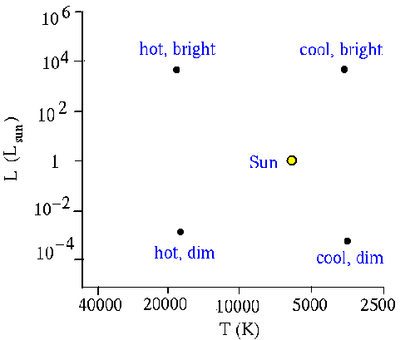
Hertzsprung-Russell diagrams
Hertzsprung and Russell independently plotted stellar luminosity vs temperature (or spectral type) –
100th anniversary (1914…first HR diag!)
Stars populate the diagram preferentially in certain
regions. This may be partially understood in terms of luminosity of an object emitting thermal radiation:
L ~ R²T⁴

Slide 37
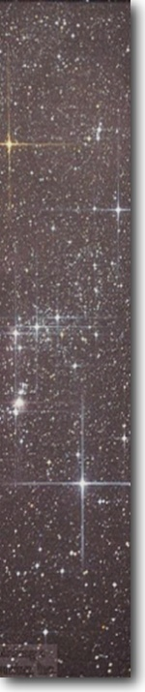
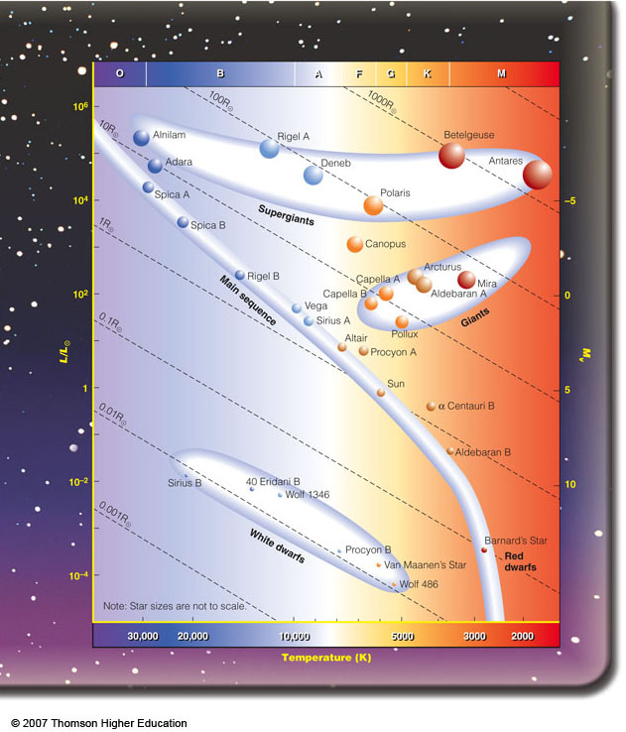
The Radii of Stars in the
Hertzsprung-Russell Diagram
0
Rigel
Betelgeuse
10,000 times the sun’s radius
Polaris
100 times the sun’s radius
Sun
As large as the sun

Slide 38
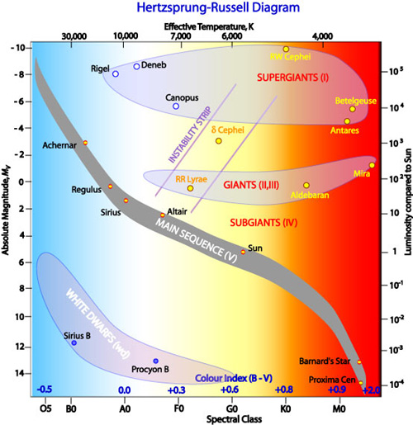
Stars: Patterns of Luminosity, surface temperature and raduis
The Hertzsprung-Russsell (H-R) diagram
Temperature
Luminosity

Slide 39
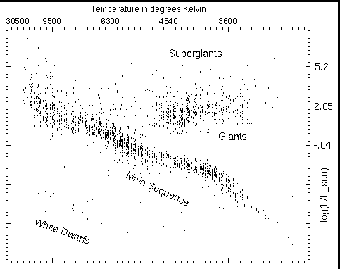
H-R diagram for nearby+bright stars:
All stars visible to the naked eye + all stars within 25 pc

